Slide 1


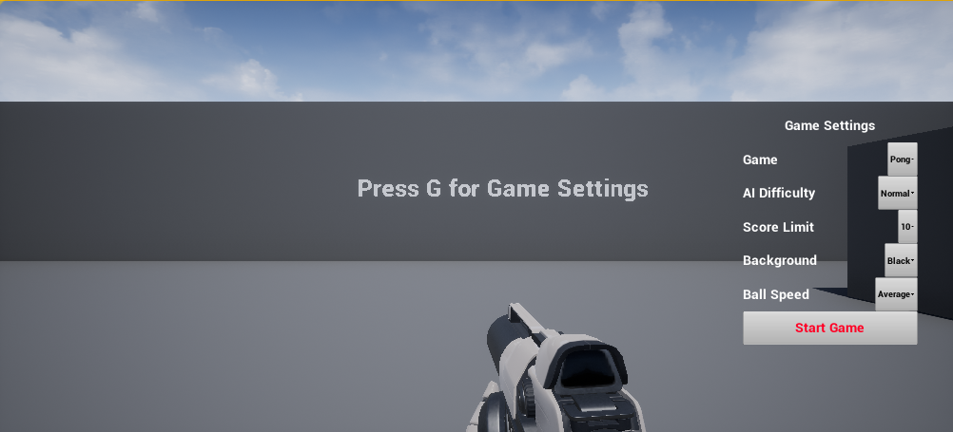
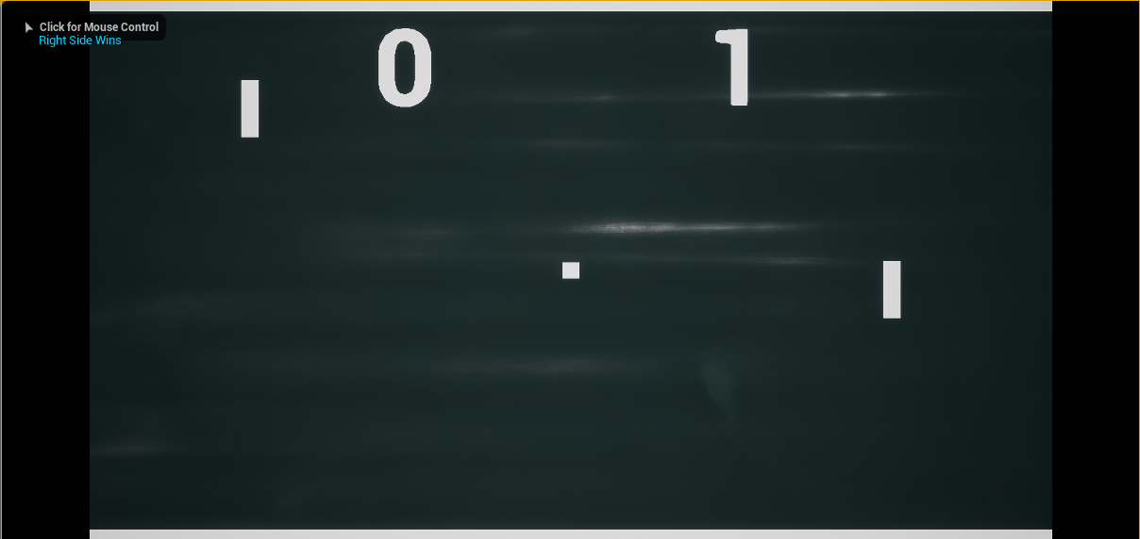
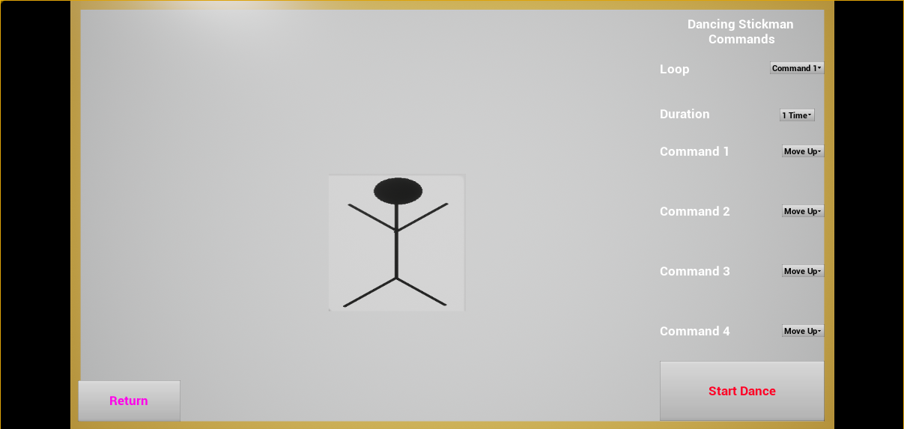
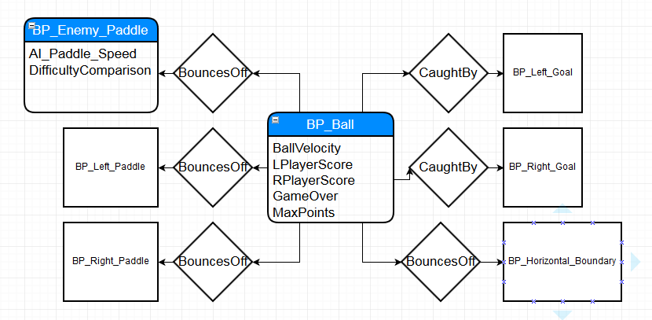
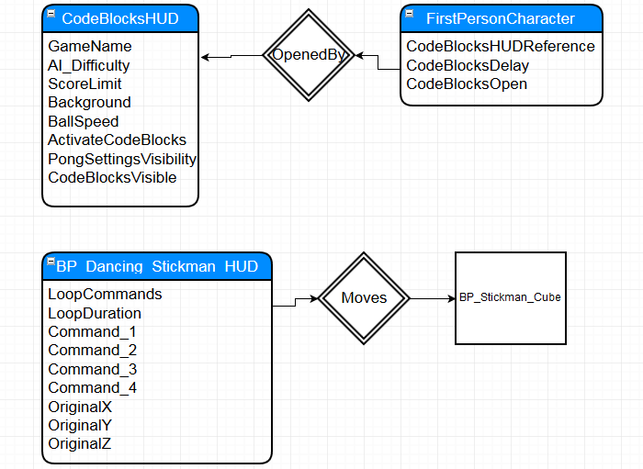
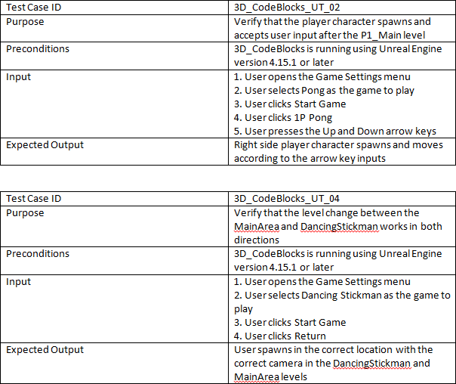
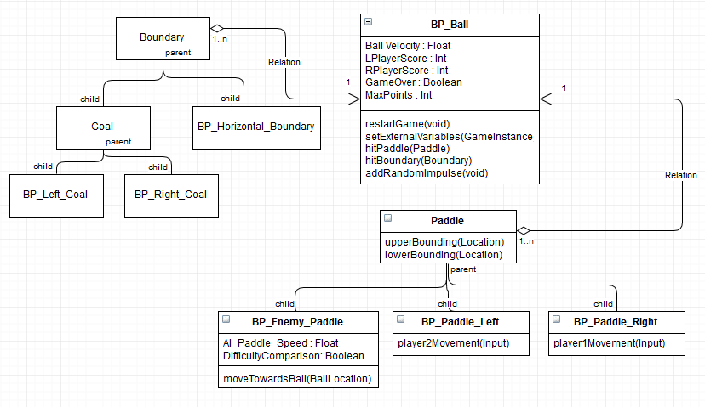
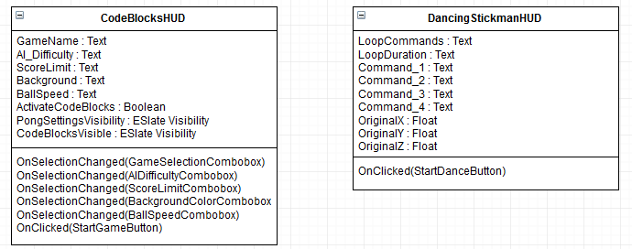
Senior Project, Spring 2017
3D CodeBlocks for Multi-touch midAir-and Motion for Virtual and Augmented Reality (TAM)
Student: Fernando de Zayas, Florida International University
Mentor: Dr. Francisco R. Ortega, OpenHID Lab
Instructor: Masoud Sadjadi, Florida International University
Problem
Computer Science has become a critical field for education and business, yet students are reluctant to enter the field due to the initial impression of programming being too difficult and complex.
Solution
The solution is to provide a simpler entry into programming, with basic concepts implemented in a simple visual format. 3D CodeBlocks presents loop and variable manipulation in relation to basic games, such as Pong or a Dancing Stickman.
Current System
Currently, students new to programming are generally introduced to the field with pure text based programming using an IDE or a visual language such as Visual Basic. These introductory methods have worked so far, but new methods should be attempted.
Screenshots
Requirements
Users must be able to:
Manipulate variables from outside of the game they affect
View the results of the new variable values in the game
Manipulate loops and variables to give specific output
System Design
Implementation
3D CodeBlocks has a different implementation for each level. Pong level logic is mostly contained inside of BP_Ball with some movement calculations in each Paddle blueprint. The MainArea level logic is split between the FirstPersonCharacter blueprint for command input and the CodeBlocksHUD blueprint for variable modifications. The DancingStickman level contains the loop and movement logic within BP_Dancing_Stickman_HUD
Verification
Object Design
Summary
3D Codeblocks is a program to help introduce students to programming in a simpler fashion. The loop and variable concepts are meant to be simple enough that any new user will be able to understand what they are doing and what it is affecting. With 3D Codeblocks, our team hopes more students will take an interest in programming.
Acknowledgement
The material presented in this poster is based upon the work supported by Masoud Sadjadi and Dr. Francisco R. Ortega. I am thankful to the help that I received from my group member Taufiq Islam.
Notes:
1

